Slide 1
KAGA Insurance Analytics
By:
Anustha Gupta (141185)
Atishay Srivastav (141193)
Ayushi Jain (141200)
Bhanu Pratap Kaushik (141203)
Kanishka Sharma (141237)
Kushagra khare (141246)

Slide 2
Content
Introduction
Objectives
Tools used
Functional Requirements
Data Integration and SQL Server Data Tools 2015
Reporting and Power BI Desktop
Work Done
ER diagram
Results
References

Slide 3
Introduction
KAGA Insurance Analytics is a data analysis project that provides reporting dashboard for an Insurance Corporation. It provides services that can be used to generate reports for business performance analysis of a company, based on different factors.
The Insurance Companies have two types of customers i.e. Individual customers and Company customers. According to the type of customer, the insurance policies are provided by the company. An Insurance policy even have different sub categories providing varieties of options to the customers.
The research draws attention towards comparison of performances of different companies based on annual analysis, sales analysis, profit analysis, etc.

Slide 4
Objective
Insurance analytics can be able to expand customer relationship, improve internal performance management, carry out risk-based pricing for better profitability, get a better understanding of new threats and prevent big losses early, better management decisions, understand customer needs.

Slide 5
Tools used
SQL Server Data Tools 2015
SQL Server Management Studio 2016
Power BI Desktop

Slide 6
Functional Requirements
Data Extraction: Data Extraction is the process of collecting data from various raw databases based on the business requirements[1].
Data Cleansing: Data Cleansing is the process of removing unnecessary data by applying certain transformations[1]. They are:
Data Conversion
Conditional Split
Aggregate
Derived Column
Lookup

Slide 7
Functional Requirements
Data Integration: Data Integration is the process of collecting data from various sources by maintaining integrity and reliability[1]. Using data integration random data generated in various files can be combined into a single file. The tool used for integration is SQL Server Data Tools 2015.
Reporting: Reporting is the pictorial representation of various information. The tool used for reporting is Power BI Desktop[3].

Slide 8
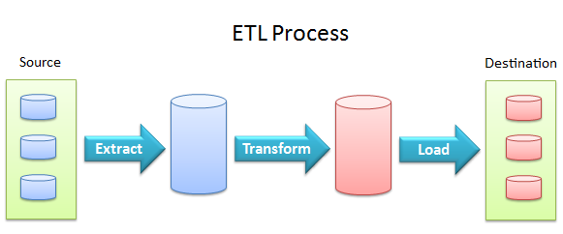
Data Integration And SQL Server Data Tools
Data integration involves combining data residing in different sources and providing users with a unified view of these data[1].
Figure1.1 ETL Process

Slide 9
Reporting And Power BI Desktop
Power BI is a suite of business analytics tools that deliver insights throughout your organization[3]. Connect to hundreds of data sources, simplify data prep, and drive ad hoc analysis. Produce beautiful reports, then publish them for your organization to consume on the web and across mobile devices. Everyone can create personalized dashboards with a unique, 360-degree view of their business. And scale across the enterprise, with governance and security built-in.

Slide 10
Work Done
Interacted with the clients and Identified requirements.
Identified Dimensions and Facts tables and Gathered Information from Raw Data.
Applied transformations on data and loaded data into the database.
In Power BI got connected to database and loaded the required tables for creating reports.
As per user requirements a new report is created. Data is inserted to report and formatting is applied to report as per requirements.

Slide 11
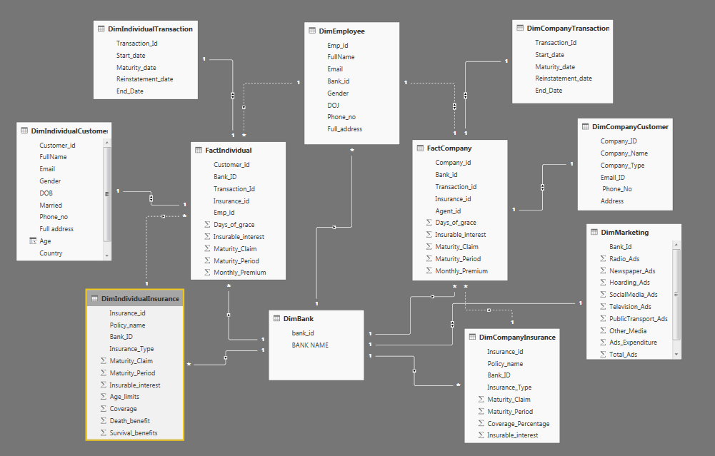
ER Diagram
Figure1.2-ER Diagram

Slide 12
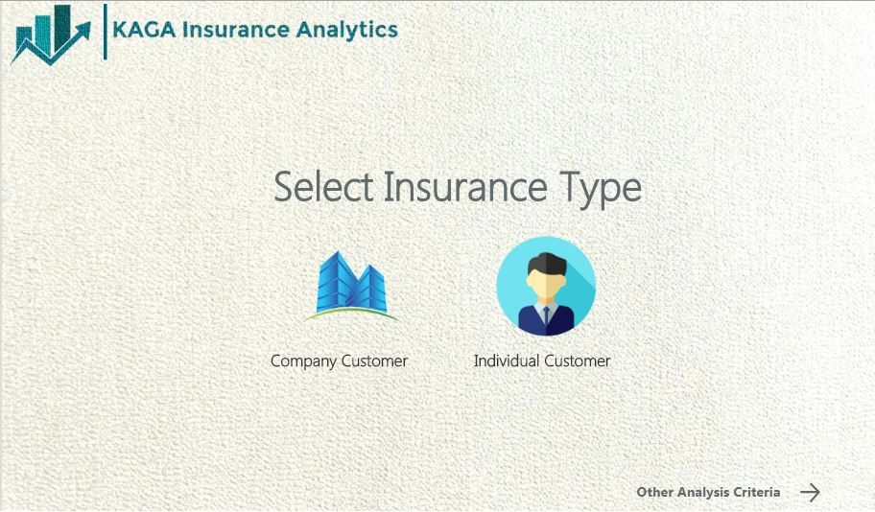
Results
Home page

Slide 13
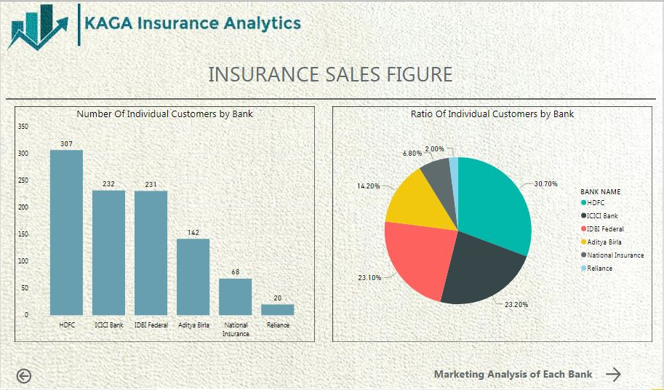
Results
Insurance Sales for each Policy type

Slide 14
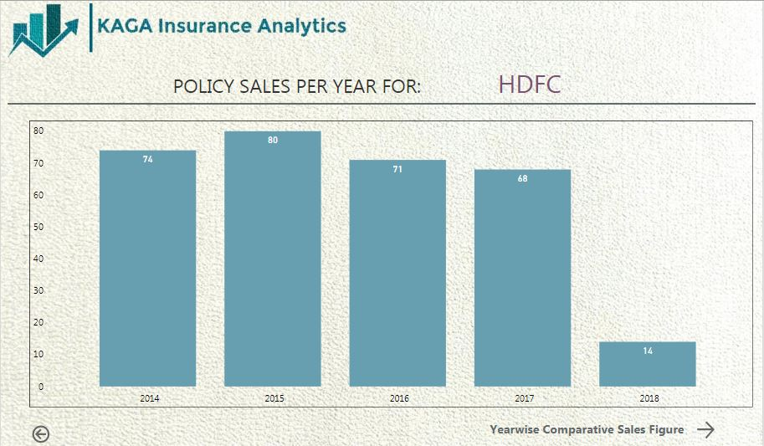
Results
Policy Sales per year for a particular Bank

Slide 15
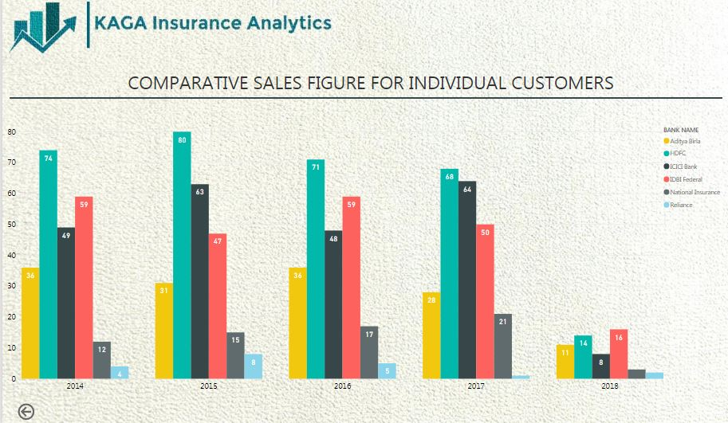
Results
Year wise comparison between sales of policies of different banks

Slide 16
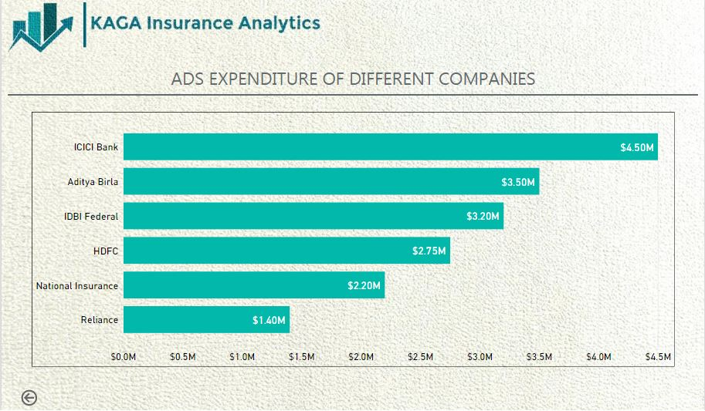
Results
Marketing Analysis of each Bank

Slide 17
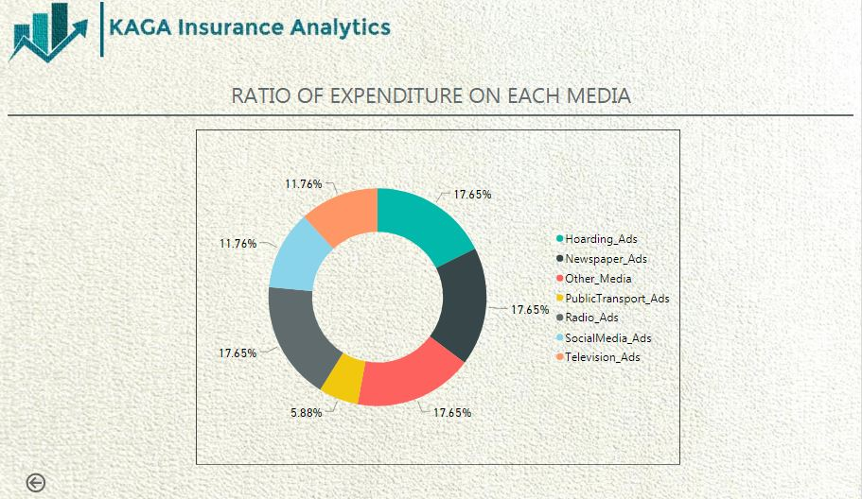
Results
Expenditure by a Bank on different Medias

Slide 18
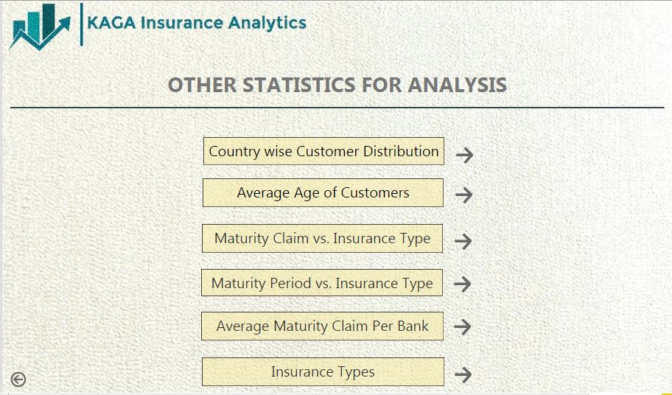
Results
Other Analysis Criteria

Slide 19
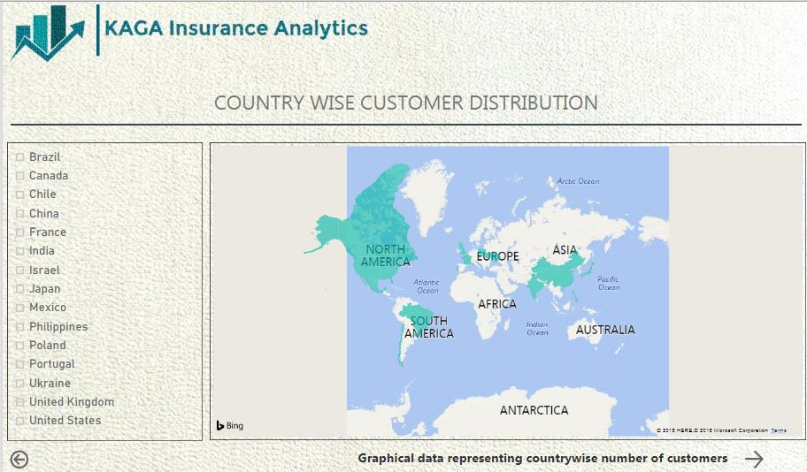
Results
Country wise Customer distribution

Slide 20
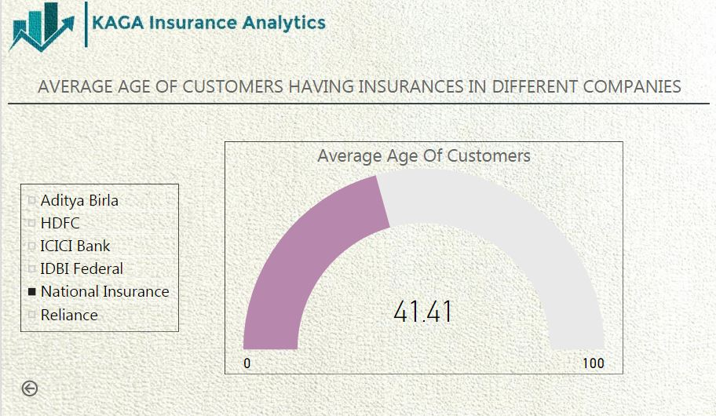
Results
Average age of customers in different banks having insurance policies

Slide 21
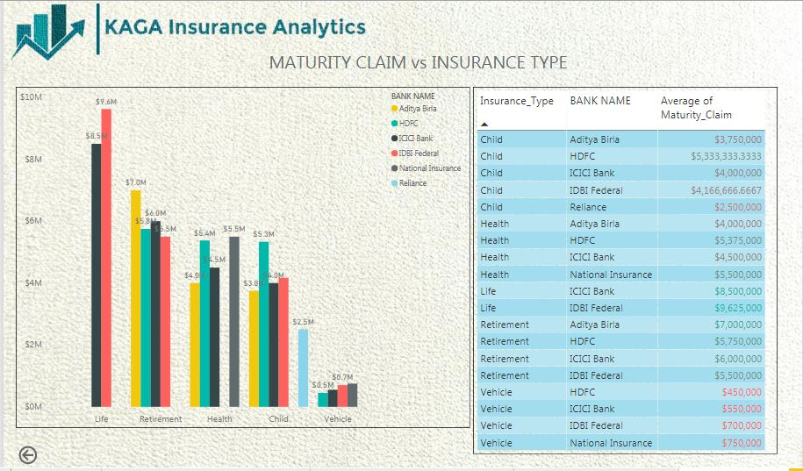
Results
Maturity claim offered on each policy type by different banks

Slide 22
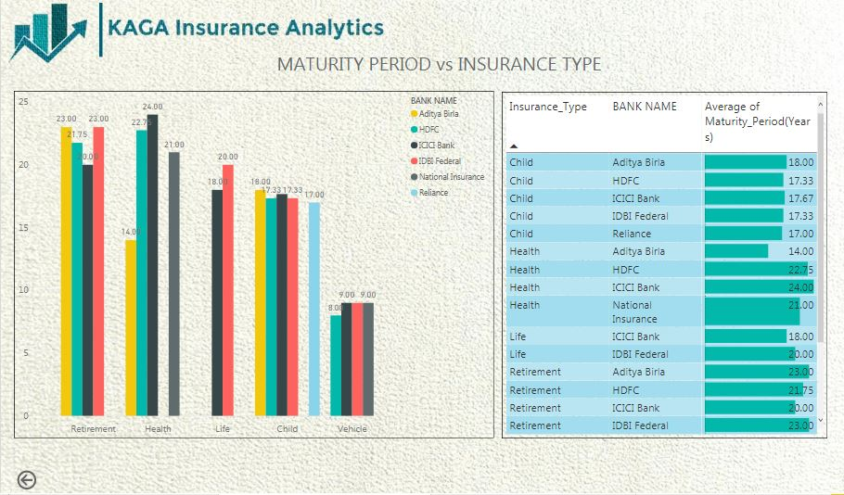
Results
Maturity period offered on each policy type by different banks

Slide 23
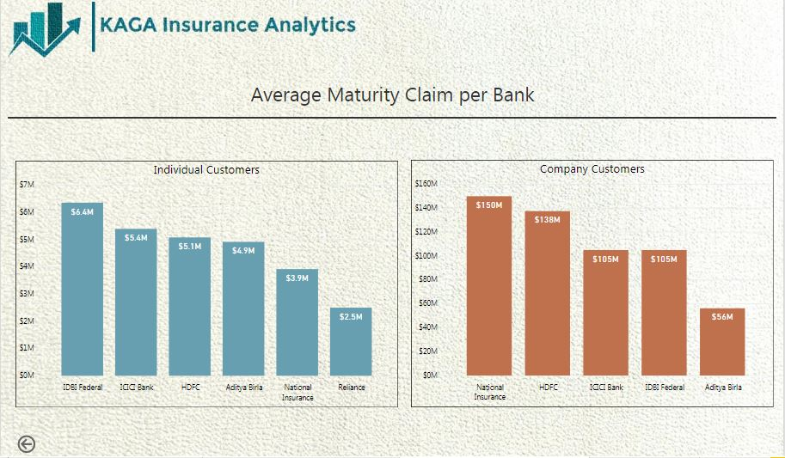
Results
Average maturity claim offered by each bank

Slide 24
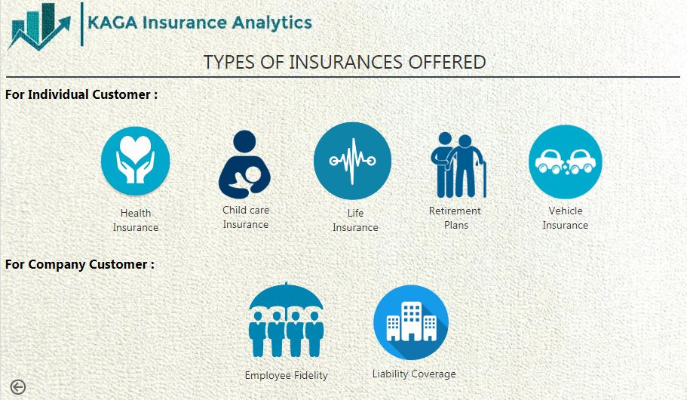
Results
Types of Insurances offered for individual and company customers

Slide 25
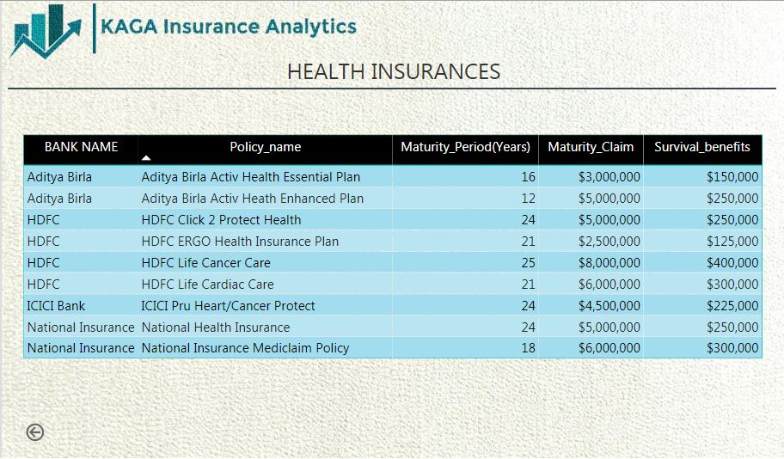
Results
Information about Health insurance offered to individual customers

Slide 26
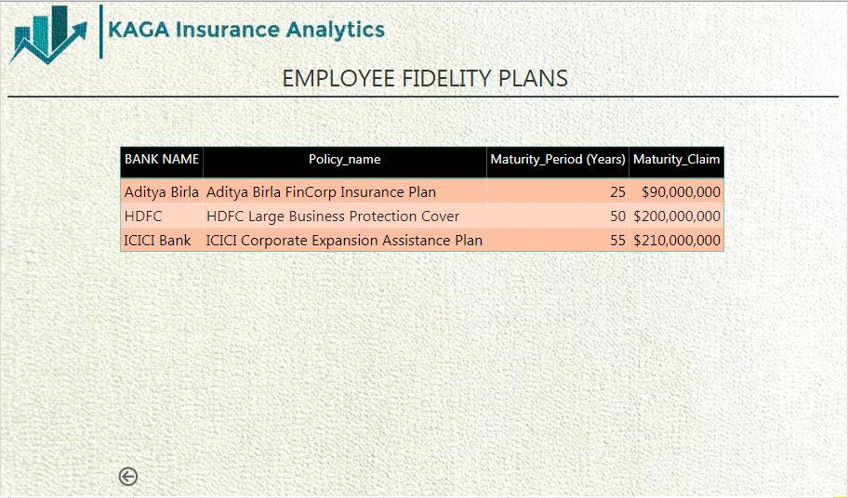
Results
Information about Employment Fidelity offered to Company customers

Slide 27
Conclusion
The created analysis project provides an insight for comparison between innumerable aspects of the insurance sector. The KAGA INSURANCE ANALYTICS is a project that provides analysis and comparison features to its users so that they are able to compare and find the most suitable policies underlying within certain branches of the corresponding banks.

Slide 28
References
[1] https://docs.microsoft.com/en-us/sql/integration-services/sql-server-integration-services?view=sql-server-2017
[2] https://docs.microsoft.com/en-us/sql/ssms/download-sql-server-management-studio-ssms?view=sql-server-2017
[3] https://docs.microsoft.com/en-us/power-bi/guided-learning/
[4] https://www.infosys.com/data-analytics/verticals/Pages/insurance.aspx
[5] https://iedunote.com/types-of-insurance

